Slide 1
CASE STUDY-BTM LAYOUT
Presented by – Surendra Upadhyay

Slide 2
INTRODUCTION
the restaurant and food service industry to register a growth of about 10.4% CAGR for the next 5 years between 2018 and 2022 to reach Rs 5.5 trillion by 2022
Currently approximately 12,000 restaurants Bengaluru

Slide 3
BMT LAYOUT COUNT OF COISINES

Slide 4
BMT RESTRO ONLINE SERVICE | Count of url
Buffet | 19
Cafes | 79
Delivery | 2987
Desserts | 198
Dine-out | 1619
Drinks & nightlife | 21
Pubs and bars | 19
(blank) | 183
Grand Total | 5125
Competitor-
Sat raj fast food
A R FAST FOOD
Moapa restaurant
Matoshri food corner
Ladooos
SHOP PRICE IN THE AREA START FROM 8000
62RUPPES PER SQUARE FEET
BOOKING AMOUNT 40000
GEOGRAPHICAL AREA OF BMT LAYOUT
Around 45 km away from Bengaluru International Airport
11 km away from the Bangalore City Railway station
The most popular residential and commercial places in Bangalore
BTM Layout is noted for its cafés, boutiques and music venues
Bannerghatta National Park
Multi-media center Madiwala Lake which is home to rare bird species
BTM Football Club (BTMFC)

Slide 5
A&B.
PROFIT 100000
Sales Quartarly
fast food | JAN | FEB | MAR | TOTAL
Biryani | 16024 | 16527 | 16689 | 49240
Maggi | 16573 | 16833 | 16198 | 49604
eggs | 15476 | 16354 | 16016 | 47846
chicken | 16973 | 16274 | 16432 | 49679
omlets | 16306 | 16106 | 16259 | 48671
kabab | 16811 | 16819 | 16830 | 50460
Rajma Chawal | 3000 | 500 | - | 3500
Cholo puri | 1000 | - | - | 1000
TOTAL | 102163 | 99413 | 98424 | 300000
EXPENSES
items/months | JAN | FEB | MAR | Sum |  | Three months exp. | rs.
Shope rent | 14000 | 14000 | 14000 | 42000 |  | LICENCE | 40000
Maggi | 5500 | 5500 | 5500 | 16500 |  | electricity | 10000
Eggs | 6000 | 6000 | 6000 | 18000 |  | water | 8000
Chicken | 4800 | 4800 | 4800 | 14400 |  | other expense | 17400
Rice | 6000 | 6000 | 6000 | 18000 |  | Sub-total(b) | 75400
Masala | 2000 | 2200 | 2500 | 6700
Gas and other expenses | 3000 | 3000 | 3000 | 9000
Sub-total(a) | 41300 | 41500 | 41800 | 124600
total expenses(a+b) | 200000
item/rate | RATE /PLATE | TOTAL IN JAN | AVERAGE /DAY | TOTAL IN FAB | AVERAGE /DAY2 | TOTAL IN MARCH | AVERAGE /DAY3
Biryani | 40 | 401 | 13 | 413 | 14 | 417 | 14
Maggi | 40 | 414 | 14 | 421 | 14 | 405 | 13
eggs | 30 | 516 | 17 | 545 | 18 | 534 | 18
chicken | 50 | 339 | 11 | 325 | 11 | 329 | 11
omlets | 40 | 408 | 14 | 403 | 13 | 406 | 14
kabab | 50 | 336 | 11 | 336 | 11 | 337 | 11

Slide 6
C
Loss -30081
SALES OF APRL & MAY
fast food | APRIL | MAY | TOTAL
Biryani | 10703 | 8751 | 19454
Maggi | 10319 | 8724 | 19043
eggs | 11058 | 7480 | 18538
chicken | 9673 | 7824 | 17497
omlets | 9666 | 8918 | 18584
kabab | 11755 | 7848 | 19603
TOTAL | 63174 | 49545 | 112719
EXPENSES
ITEM/MONTHS | APRIL | MAY | TOTAL |  | 2 months exp | RS.
Shope rent | 14000 | 14000 | 28000 |  | ELECTRICITY | 7000
Maggi | 5500 | 5500 | 11000 |  | WATER | 5000
Eggs | 6000 | 6000 | 12000 |  | LICENCE | 30000
Chicken | 4800 | 4800 | 9600 |  | OTHER EXPENSES | 18000
Rice | 6000 | 6000 | 12000 |  | SUB TOTAL(d) | 60000
Masala | 2000 | 2200 | 4200
Gas and other expenses | 3000 | 3000 | 6000 |  | TOTAL EXPENSES(c+d) | 142800
SUB TOTAL(c) | 41300 | 41500 | 82800
ITEMS | RATE /PLATE | TOTAL IN APRIL | AVERAGE /DAY | TOTAL IN APRIL 2 | AVERAGE /DAY3
Biryani | 40 | 268 | 9 | 219 | 7
Maggi | 40 | 258 | 9 | 218 | 7
eggs | 30 | 369 | 12 | 249 | 8
chicken | 50 | 193 | 6 | 156 | 5
omlets | 40 | 242 | 8 | 223 | 7
kabab | 50 | 235 | 8 | 157 | 5

Slide 8
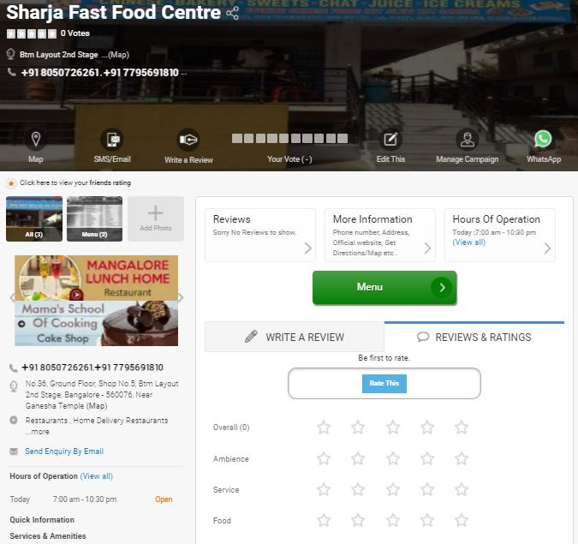
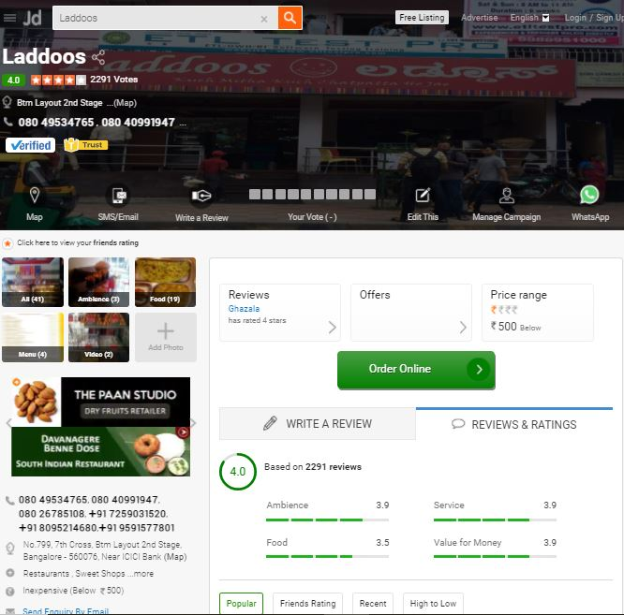
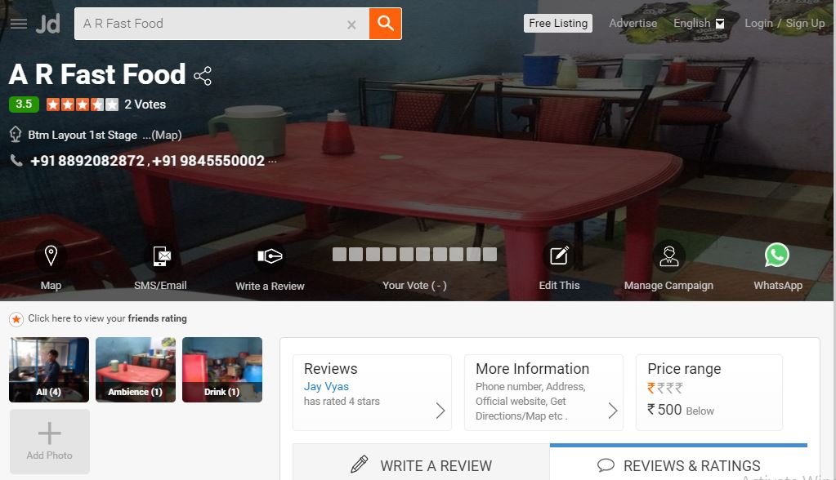
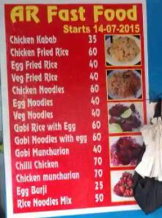

Slide 9
SOLUTION CAN BE-
Requirement of quality improvement
Required to provide online delivery
Should register for just dial ,swingy , Zomato and online food retails services
Expenses are higher than profit
Quick service and delivery
Can remove shop from here to place near
Customer relationship management requirement and feedback
Proper management requirement for finance and operation
Should have more hygiene and customer center food
Provide offer on weekends with good quality food

Slide 10
Thank you

